Slide 1
The Agentic Repository Automation Revolution
Don Syme, Peli de Halleux, Mara Kiefer + many others
May 2026
Notes:
Note: Put phone on do not disturb, Slack to not notify, Teams closed
Thank you for the introduction, Rahul. Again, my name is Eddie Aftandilian. I’m a principal researcher in GitHub Next, and today I’ll be sharing some lessons that we have learned from building GitHub Copilots.

Slide 2
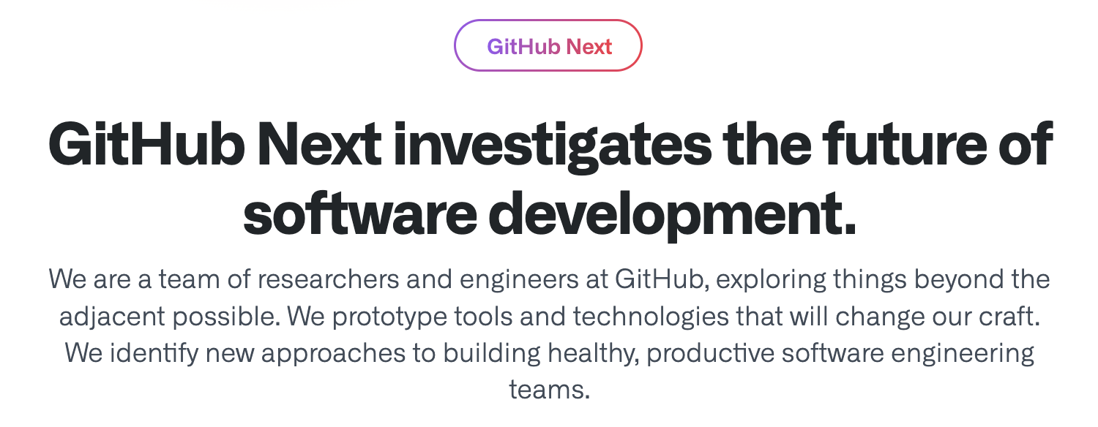
GitHub Next
Research, Build, Balance, Ship, Learn

Slide 3

We live in the most incredible of times
AI and traditional dev tools make us all magicians when it comes to code
Everything is changing, yet continuity is there too
Notes:
AI developer tools are changing the way we write software.
GitHub Copilot was one of the first such tools. It launched as a technical preview (essentially a closed beta) in June 2021. Today it has 1.8M paying users, and 50% of those users’ code is written by Copilot. Other companies such as Google report similar proportions of AI-generated code for their comparable AI code completion tools.
This will only increase as the next generation of tools comes online. These are tools that approach the problem at a higher level – for example, completing an entire development task as opposed to completing a line of code or a function
Copilot Workspace, Devin, Cursor, et al.

Slide 4

We live in the most incredible of times
AI and traditional dev tools make us all magicians when it comes to code
Everything is changing, yet continuity is there too
Notes:
AI developer tools are changing the way we write software.
GitHub Copilot was one of the first such tools. It launched as a technical preview (essentially a closed beta) in June 2021. Today it has 1.8M paying users, and 50% of those users’ code is written by Copilot. Other companies such as Google report similar proportions of AI-generated code for their comparable AI code completion tools.
This will only increase as the next generation of tools comes online. These are tools that approach the problem at a higher level – for example, completing an entire development task as opposed to completing a line of code or a function
Copilot Workspace, Devin, Cursor, et al.

Slide 5
Continuous AI

Slide 6
Continuous AI
implemented by
GitHub Agentic Workflows

Slide 7
GitHub Agentic Workflows
= The coding agents you love running automated in safe sandboxes with strong guardrails in GitHub Actions

Slide 8
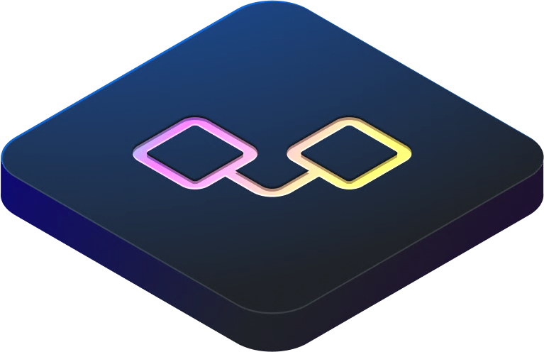
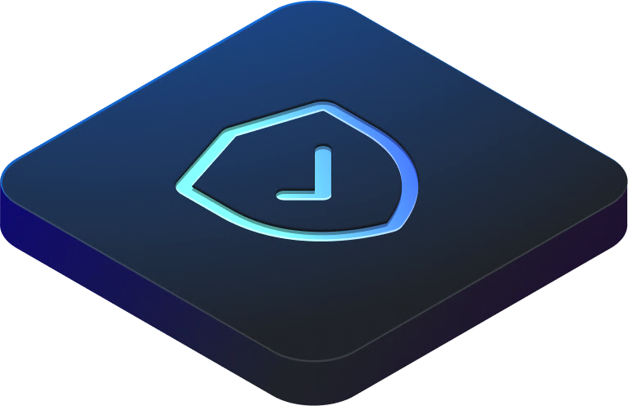
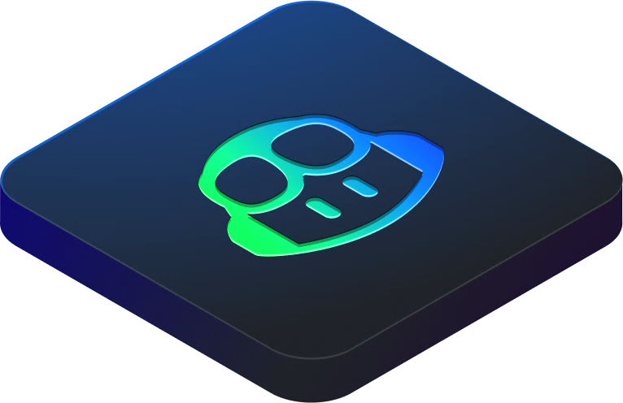
GitHub Agentic Workflows
Agentic human processes powered GitHub.
Automation
Workflows executed via GitHub Actions written in natural language.
Automation
+
Automation
Isolated sandboxes with scoped permissions and network control.
Safety
+
Automation
Agents interpret intent & operate on context across models. Copilot CLI · Claude · Codex · Gemini
Reasoning

Slide 9
Example - Weekly Researcher
---
on:
schedule:
- cron: "0 9 * * 1" # Every week, 9AM UTC, Monday
workflow_dispatch:
safe-outputs:
create-issue:
tools: web-search: ---
# Agentic Weekly Researcher (Ruby)
Do a deep research investigation in ${{ github.repository }} repository, and the related industry in general.
- Read selections of the latest code, issues and PRs for this repo.
- Read latest trends and news from the software industry news source on the Web.
Create a new GitHub issue containing a markdown report with interesting news about the area related to this software project, related products and competitive analysis, related research papers, new ideas, market opportunities, business analysis, enjoyable anecdotes.
> NOTE: Include a link like this at the end of the report:
```
> AI-generated content by ${{ github.workflow }}, may contain mistakes.
```
Triggers
Safe output specs
NL programming = deliberate ambiguity = genuinely useful ambiguity
Tools
Actions-familiar
Assumes GitHub
Self-reporting

Slide 10
Example - Issue Triage
---
on:
issues:
types: [opened, reopened]
safe-outputs:
add-comment:
---
# Agentic Issue Triage
Your task is to analyze issue #${{ github.event.issue.number }} and perform some initial triage tasks related to that issue.
Analyze the issue content. Write notes, ideas, nudges, resource links, debugging strategies and/or reproduction steps for the team to consider relevant to the issue. Select appropriate labels already used in the repository and apply them to the issue.
Finalize an output report with your analysis and add it as an issue comment to the issue.
> NOTE: Include a link like this at the end of your issue comment:
```markdown
> AI-generated content by ${{ github.workflow }}, may contain mistakes.
```

Slide 11
Agentic Workflows - Getting Started
Samples
gh extension install github/gh-aw gh aw add githubnext/agentics/daily-test-improver <secret+commit+push> gh aw run daily-test-improver --repeat 30

Slide 12
Agentic Workflows - Safety, Safety, Safety
Execution is VM-sandboxed (GitHub Actions VMs)
Overall permissions are minimized
Agentic steps run essentially read-only
All outputs are “in the intended channel” (“safe outputs”)
blast radius greatly reduced
checked by AI for safety
human oversight guaranteed
Outgoing network is firewalled and controlled

Slide 13
Continuous AI
implemented by
Agentic Workflows
enables
Agent Zoo

Slide 14
Continuous AI
implemented by
Agentic Workflows
enables
Continuous Engineering

Slide 15
Continuous AI
implemented by
Agentic Workflows
enables
Continuous Repository Maintenance

Slide 16
Demo – Repo Assist

Slide 17
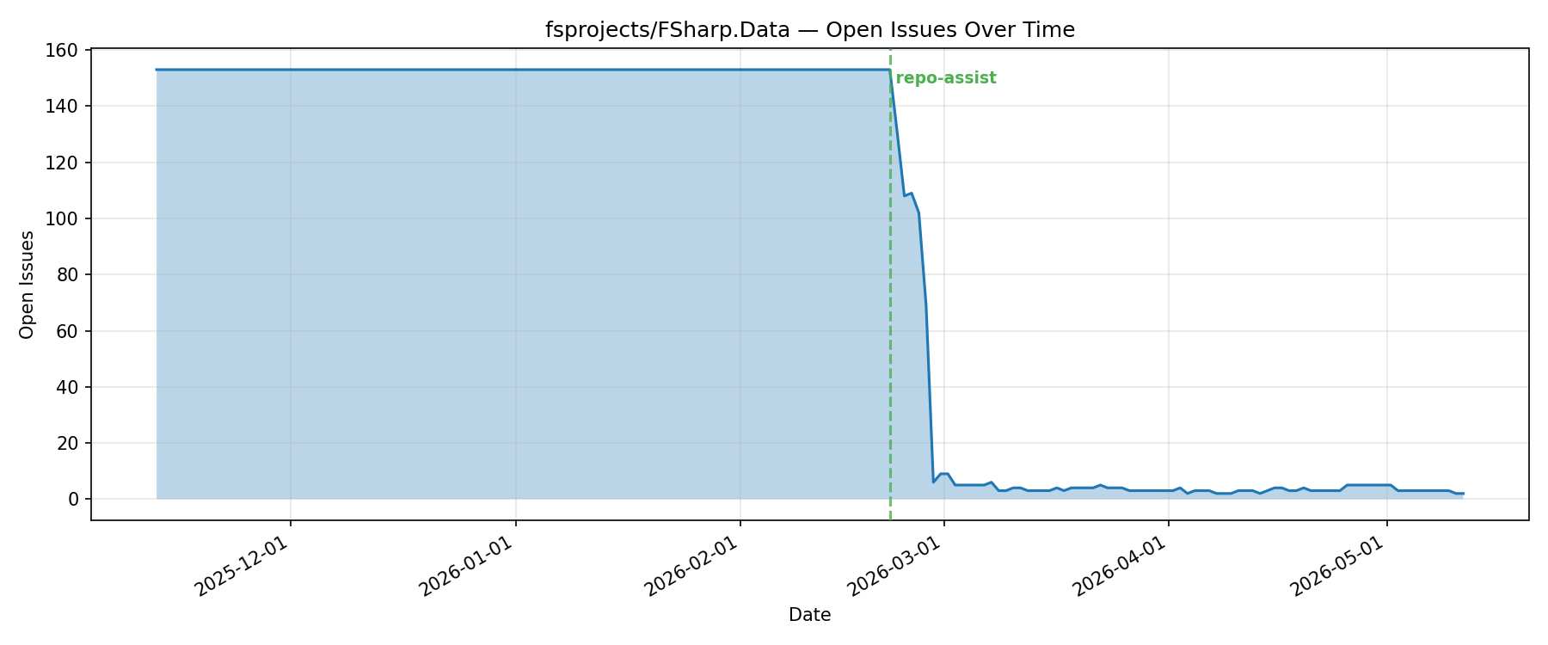

Slide 18
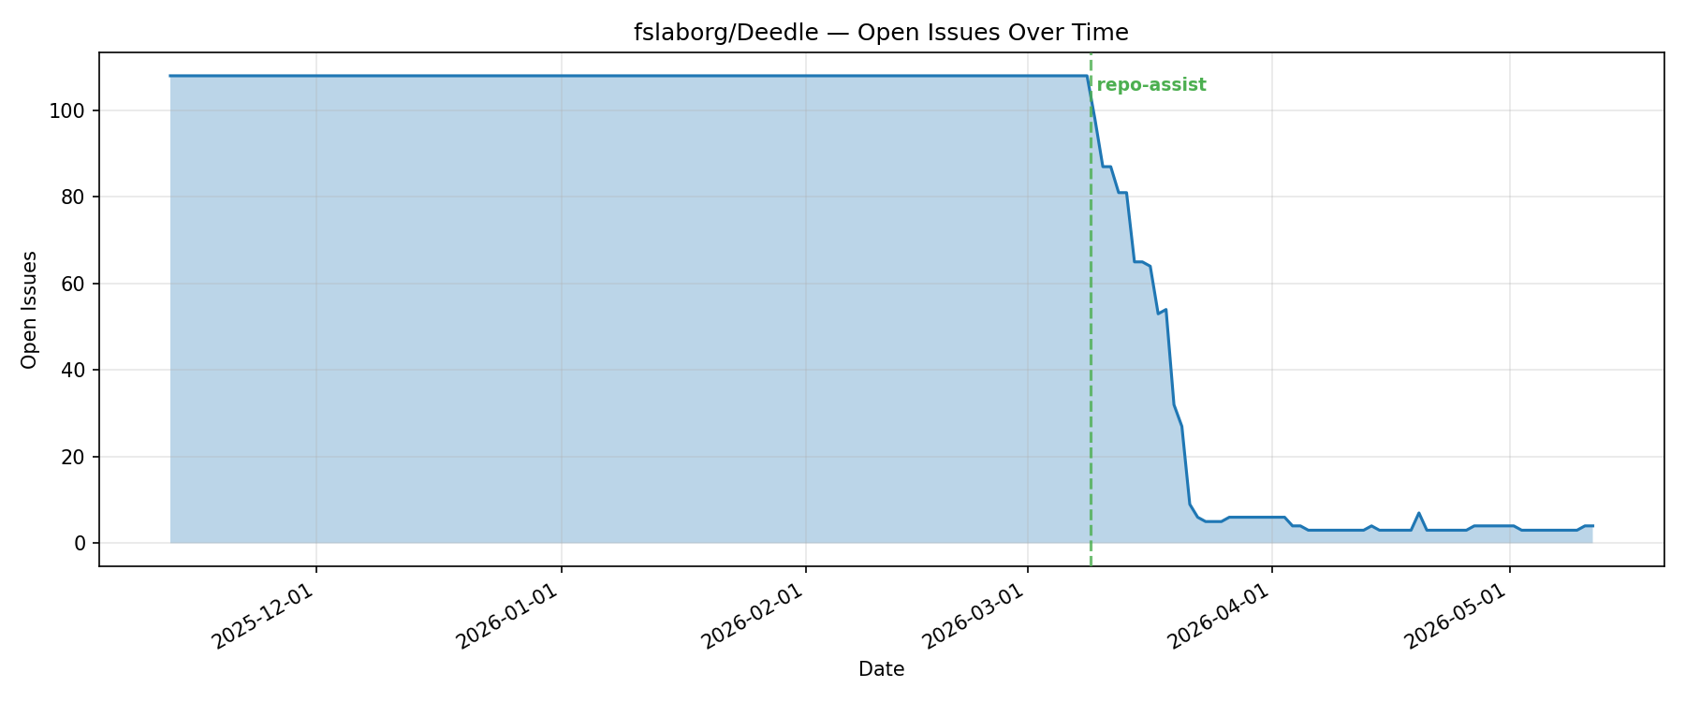

Slide 19
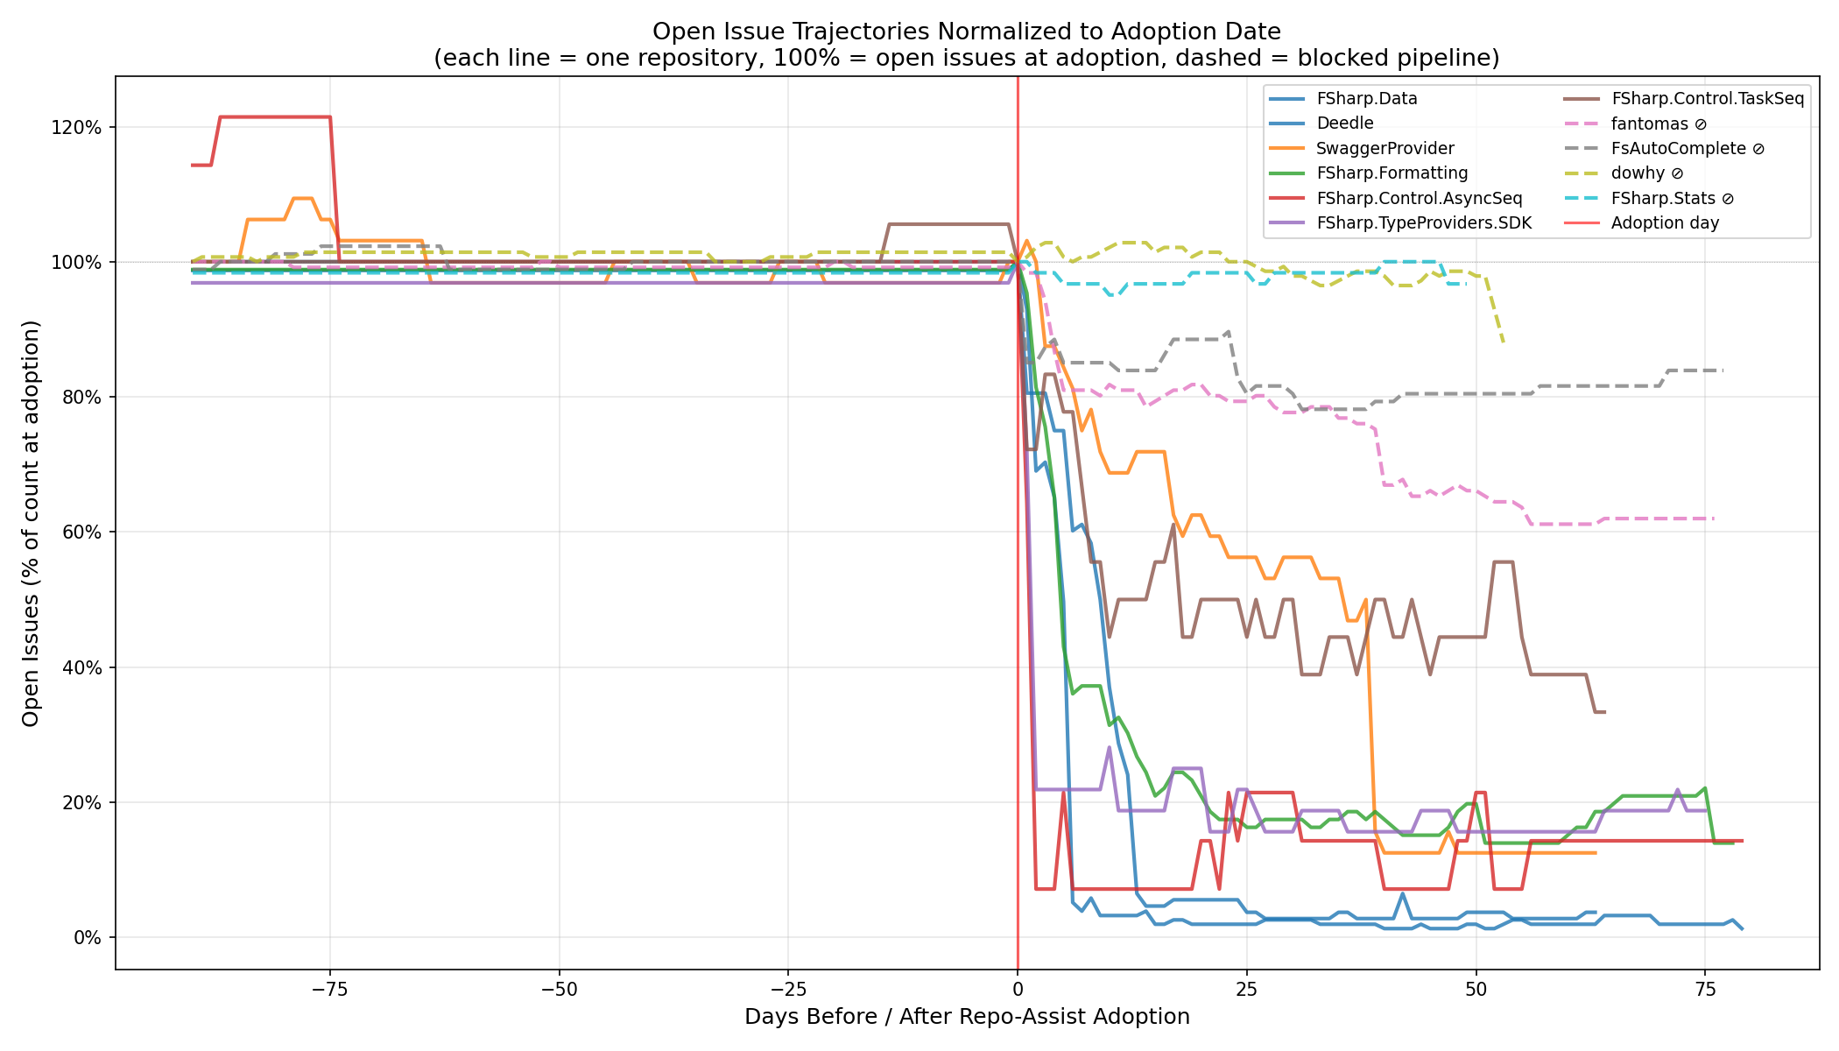

Slide 20
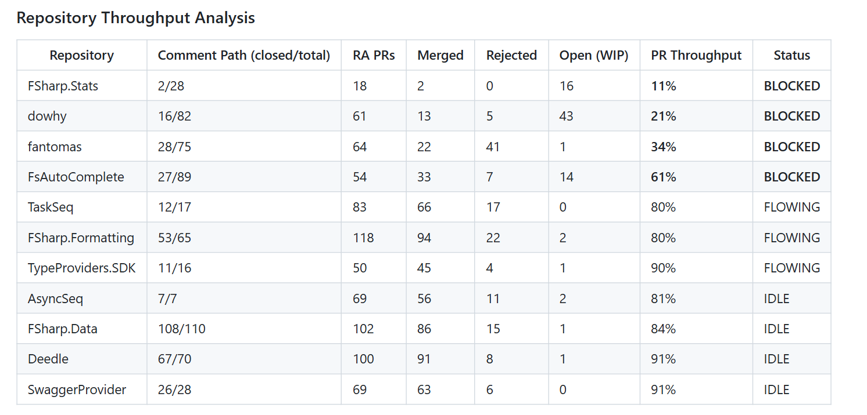

Slide 21
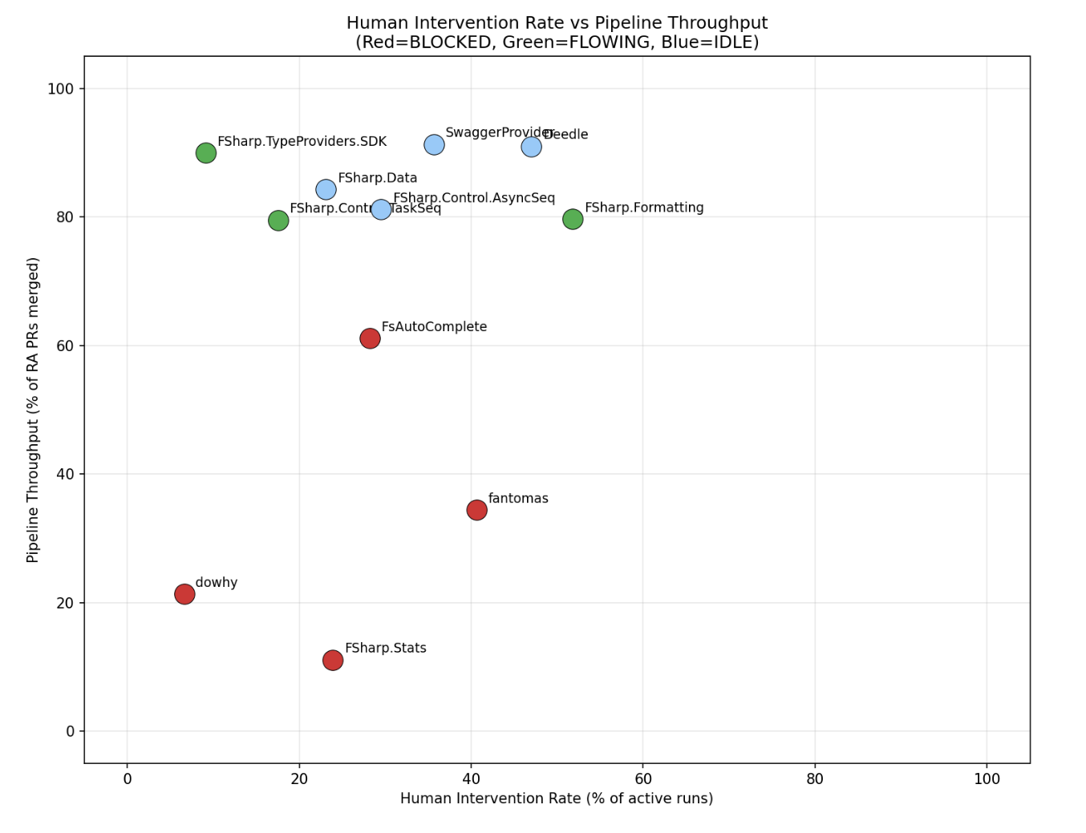

Slide 22
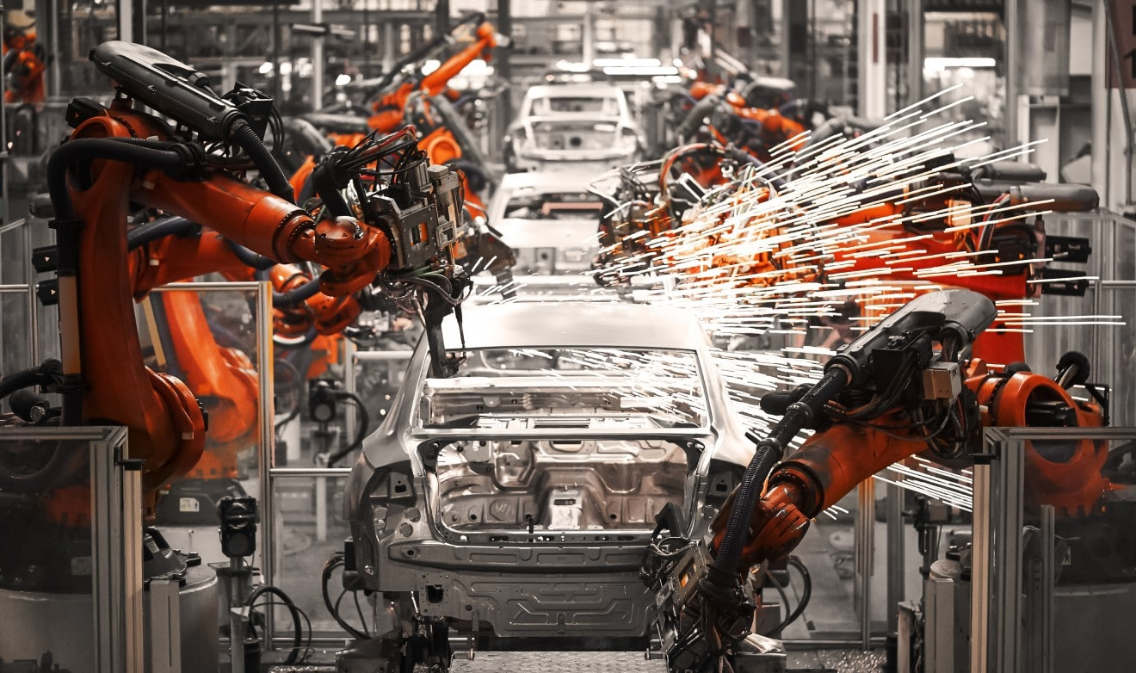
Theme 5: The Repository as an Automated Software Factory
Continuous Integration
Continuous Deployment
Continuous AI
Notes:
The original GitHub Copilot completes code in your editor
You have to accept small bits
You have to move your cursor around
You still have to type quite a lot
Copilot has to infer what you are trying to do
Can we switch POV to whole task, whole change, whole repository
While keeping the key learning of Copilot: repeated AI-user alignment

Slide 23

GitHub Next
Investigating the future of software development
githubnext.com

Slide 24
AI Dev Tools are changing fast
2022: GitHub Copilot Code Completions launched.
1.8M+ paying users, 50%+ of users’ code is written by Copilot
2023: AI Assists expand in traditional Developer Environments
Summarization, advice, code review, e.g. Cody and others
2024: Shift to Task-orientation
GitHub Copilot Workspace, Cursor Composer, Devin bring task-orientation to the IDE
2025: Coding Agents developed to explore and use tools
Cursor/VS Code Agent-Mode, Claude Code and others launched
2025: AI-assisted app development introduced
GitHub Spark, Bolt, Gemini, Lovable, Cogna, …
2025: Continuous AI introduced
GitHub Agentic Workflows, Google Jules, Curor Automations
Proactive, automated use of AI

Slide 25
Theme 6: New Futures, New Work
The Future is Work that wasn’t being done before
Automobile
Led to travel that wasn’t being done before
Factory
Led to millions of products that weren’t being produced before
Medicine
Led to many diseases that weren’t being treated before
More overall work, not less
New work, not less work
Notes:
The original GitHub Copilot completes code in your editor
You have to accept small bits
You have to move your cursor around
You still have to type quite a lot
Copilot has to infer what you are trying to do
Can we switch POV to whole task, whole change, whole repository
While keeping the key learning of Copilot: repeated AI-user alignment

Slide 26
Theme 6: New Futures, New Work
Software Performance Engineering was previously expensive, adhoc, ephemeral
→ AI-automated performance engineering now tractable
→ Needs human expertise and oversight
→ Good work that was too expensive to do
Formal Verification was previously very expensive, rare
→ AI-automated formal verification now looking tractable
→ 100x less expensive
→ Needs human expertise and oversight
Software Maintenance was previously very expensive, needed experts
→ AI-assisted software maintenance now tractable
→ 20x(?) less expensive
→ Needs human expertise and oversight
Notes:
The original GitHub Copilot completes code in your editor
You have to accept small bits
You have to move your cursor around
You still have to type quite a lot
Copilot has to infer what you are trying to do
Can we switch POV to whole task, whole change, whole repository
While keeping the key learning of Copilot: repeated AI-user alignment

Slide 27
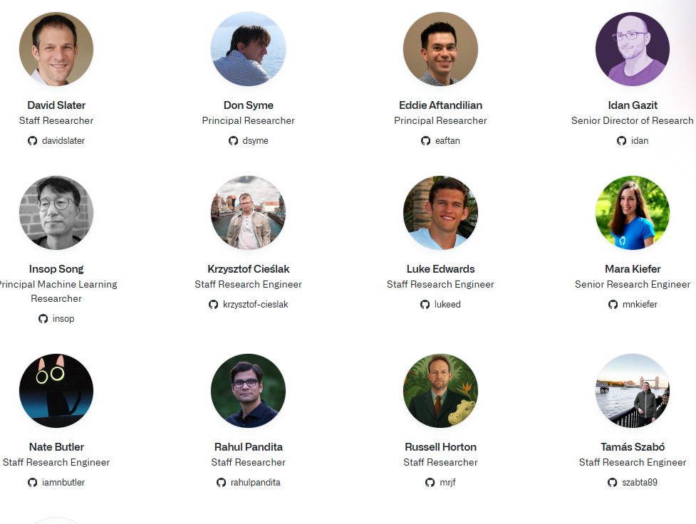
The GitHub Next Team
Notes:
I’m representing the work of an amazing team
Currently 18 people
Mix of backgrounds and skillsets
Frontend, backend, ML, programming languages, user research, etc.
It takes this diverse mix of skillsets to build new AI developer tools

